Slide 1
Java Lecture 5

Slide 2
Java Basics
Methods of String Class
  char charAt (int index);
  int length();
  String substring(int start,int length);
  String concat(String);
  String replace(char old ,char new);
  String toLowerCase();
  String toUpperCase();
  String trim();
  int compareTo(String);

Slide 3
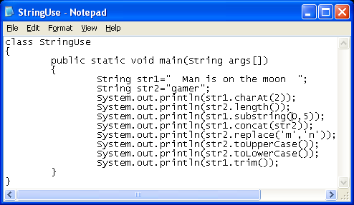
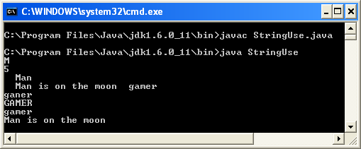
Java Basics
Example:-

